Slide 1
OpenROAD Foundations and Realization of Open, Accessible Design
Andrew B. Kahng, UCSD
abk-openroad@ucsd.edu
https://theopenroadproject.org
https://github.com/The-OpenROAD-Project
Notes:
Thank you for the invitation to OSDA 2023 -- I am very excited to be here and see so many colleagues who share the vision of open-source EDA. And this is a talk about OSDA perspectives from the OpenROAD project.

Slide 2
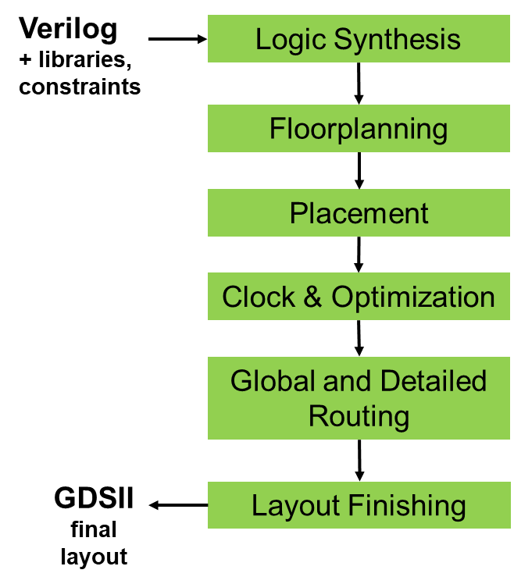

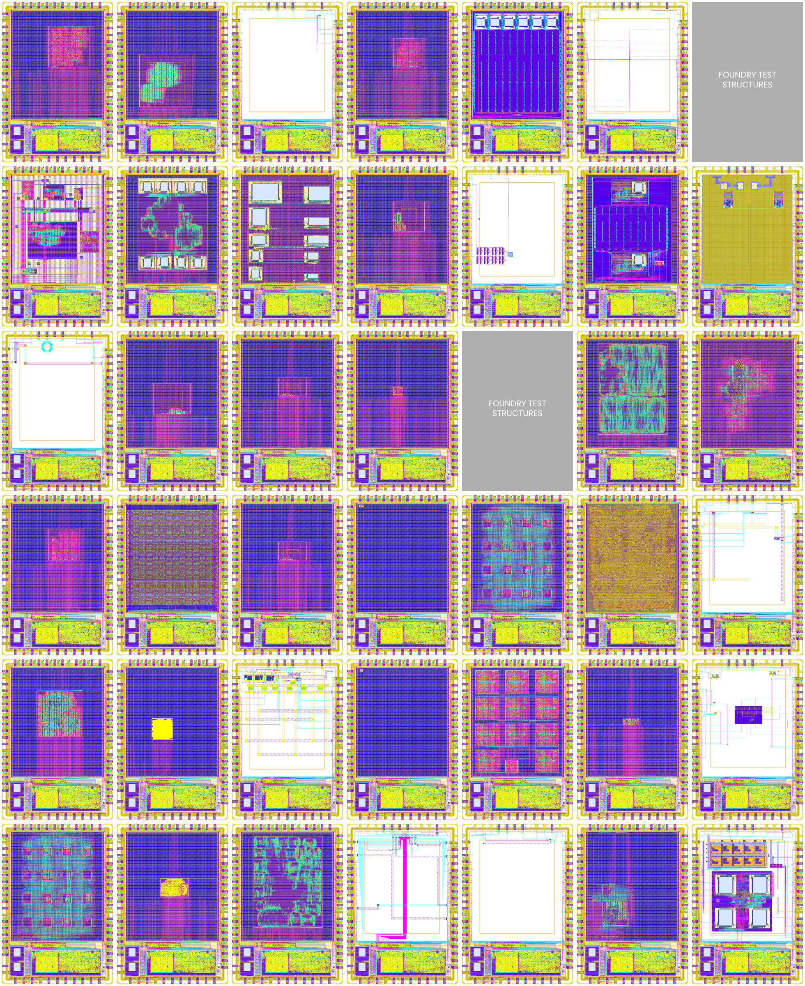
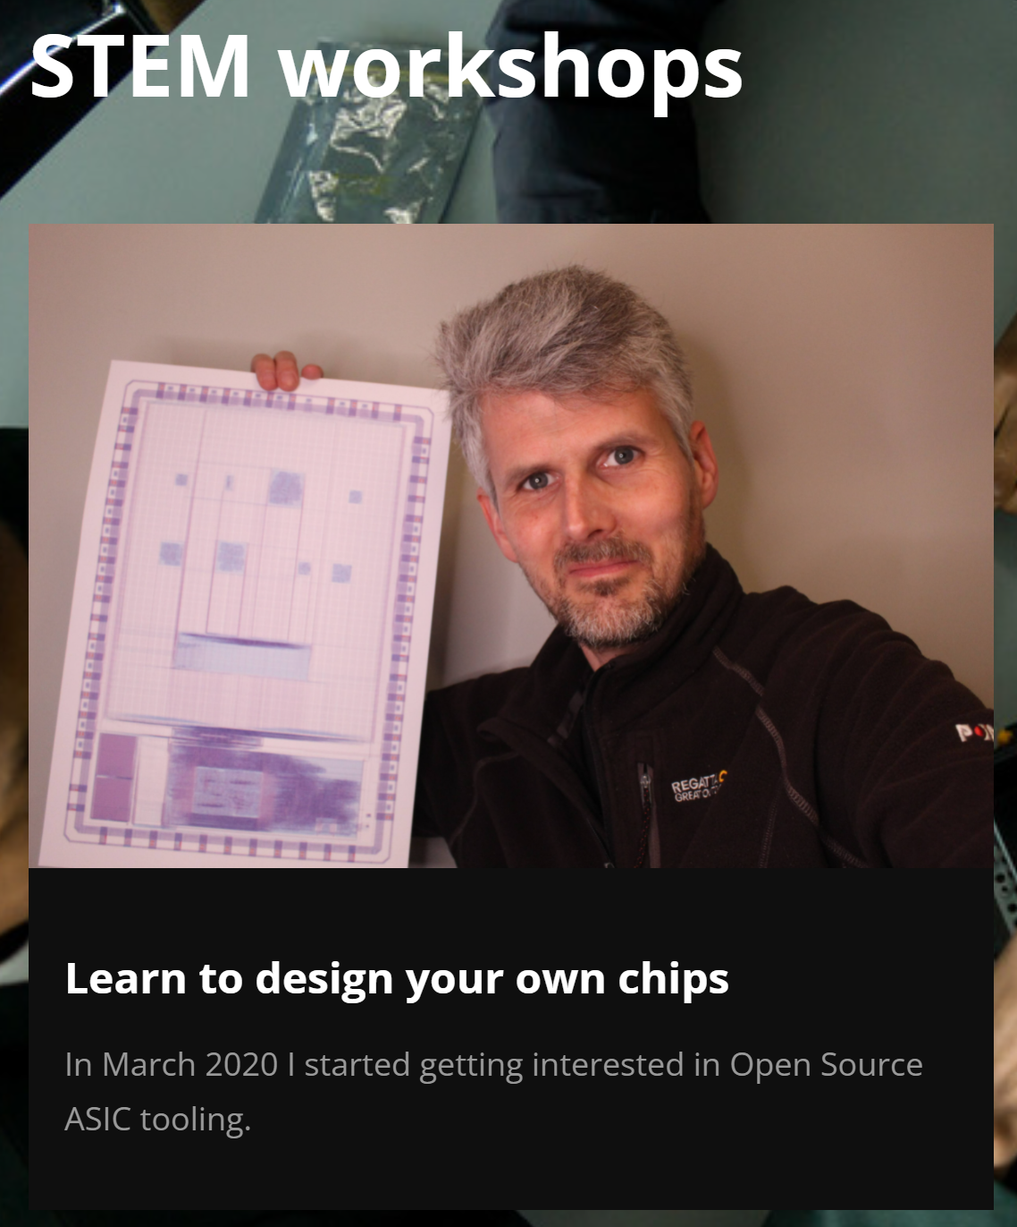
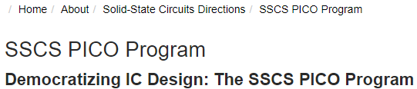
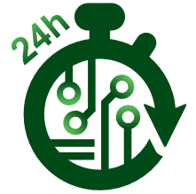



OpenROAD
Functionality: 600+ tapeouts, 130-12nm
Community: OpenROAD app has 16K commits from 77 contributors
Education and Workforce: from high school to graduate level, extension
Researchers
Small R&D teams, startups
Notes:
OpenROAD aims for no-human-in-the-loop, tapeout-clean RTL-to-GDS in FinFET nodes. [CLICK] in 24 hours.
[CLICK] The project has over 600 tapeouts in foundry 130nm to 12nm. There is a growing community of contributors and supporters. And OpenROAD supports education and outreach on many levels, whether through IEEE societies or the Google-Skywater shuttles, or contests and STEM workshops.
[CLICK] It is also the basis for research in both EDA and hardware design, and it addresses needs of small R&D teams that otherwise face too many barriers to getting ideas into silicon. Several flows have been built on top of OpenROAD.
[CLICK] And the project owes a lot to its unique partnership between academic researchers and the team of EDA veterans at Precision Innovations.

Slide 3
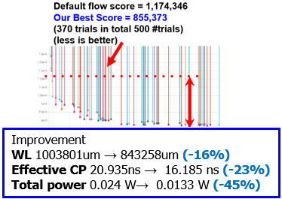
Directions:
Cloud, ML
What if tool licenses are unlimited?
“COPILOT” = Cloud Optimized Physical
Implementation using OpenROAD Technology
ML challenge: predict failure and intervene
+ low-hanging fruits such as AutoTuner
Notes:
Where is OpenROAD going? Well, we work on pretty much every green box you see here, which stretches the team’s resources. But, I want to mention two overarching directions:
[CLICK] First, what is enabled by unlimited copies running at the same time? We’ve been working on “Cloud-Optimized” physical design – what we call COPILOT – and this takes us into machine learning to predict doomed subtasks and so on.
[CLICK] There is low-hanging fruit like black-box hyperparameter optimization, or AutoTuning, which finds superior flow settings that our internal design experts never imagined. Here, we’ve recently spun up thirty thousand cloud instances in a project with Intel.

Slide 4
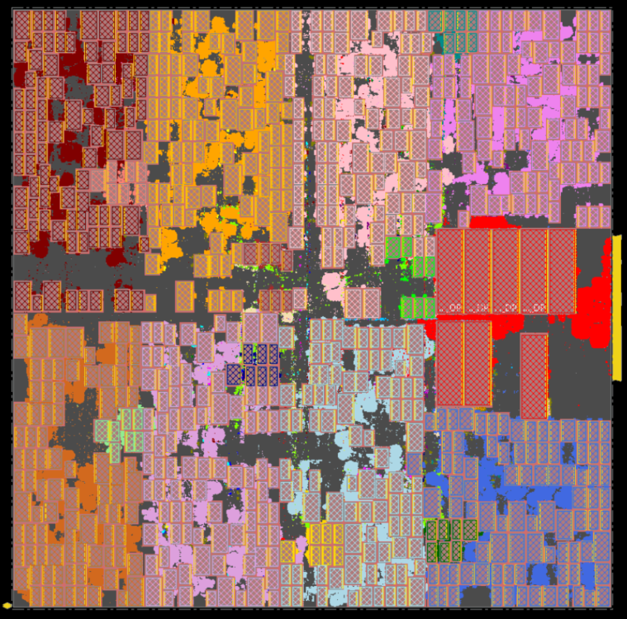
Directions: Early Design Space Exploration
Can we better explore architecture and SoC floorplan design spaces?
Hier-RTLMP: /src/mpl2
RTL and dataflow-driven, human expert-like
TritonPart: /src/par
Timing- and constraint-driven partitioner
Displaces hMETIS, KaHyPar
Notes:
The second overarching direction is to enable faster and more accurate exploration of architecture and floorplan options. Shortening the time to useful PPA feedback is incredibly valuable.
[CLICK] A new macro placer, Hierarchical RTL-MP, understands RTL hierarchy and dataflow, and it delivers very human expert-like results. This is an AI accelerator in GF 12LP with 760 macros. We think users could AutoTune this new macro placer, use it for early design space exploration, build hybrid flows with commercial tools, or other possibilities.
[CLICK] Early design exploration also depends on partitioning that understands timing and modern constraints. TritonPart is a very strong partitioner that is also new in OpenROAD.
BUT I didn’t fly from San Diego to give a 10-minute talk about OpenROAD !!!

Slide 5
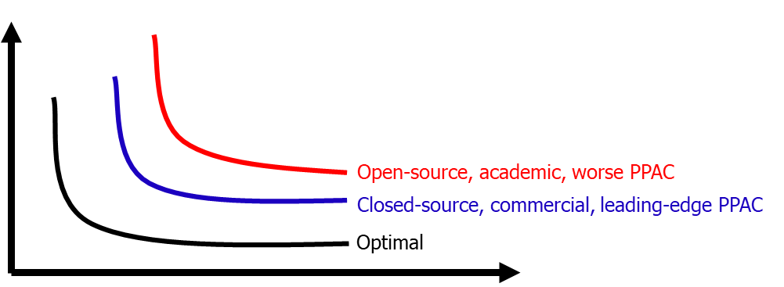

OSDA Directions
Area (Power)
= All of Us
Today
HOW?
Tomorrow
Clock Period (1/fmax)
Engines: do better
Cloud: exploit 1000s of runs
Machine Learning: generate and share data, models
Efficiency … as a Community!
Notes:
It’s much more important to think about what can be the LASTING OUTCOMES from this workshop – including DIRECTIONS for Open-Source Design Automation as a Community.
This cartoon shows the “hockey stick” of area and power on the y-axis, versus clock period (increasing on the x-axis). Open-source in red is worse than closed-source in blue, which is worse than the unknown black, “optimal” hockey stick.
And the RED hockey stick is [CLICK] All of Us.
The huge challenge for All of Us – [CLICK] is shifting the red hockey stick from today to tomorrow. [CLICK] How???
Well, one answer to “How” is – “recall the previous slides”. [CLICK] Develop better heuristics for CAD optimizations, and better engines. Jump in where traditional EDA vendors need to tiptoe around – like, cloud, or open data and hooks for machine learning.
Nah. I believe that the real challenge and the most important direction is [CLICK] efficiency as a Community. Open-source EDA has too many needs, and not enough people. So let me say a few thoughts on this.

Slide 6
Thought #1: Bars Matter
Is it good enough?
Relevance (functionality, data, quality of results)
Foundry N5 vs. ASAP7 / ASAP5
Commercial SP&R (PPAC) vs. academic/open-source SP&R
Commercial product designs vs. open hardware designs
Quality, continuous improvement
Support
Can I rely on it?
Ph.D. students vs. design/EDA professionals
Documented, maintained, supported
User community
Availability, terms and conditions
“more wood behind fewer arrows” ?
Notes:
Thought Number One: Bars Matter. A lot.
“Is it good enough?” How relevant is it in terms of functionality, data produced, quality of results and so on? Whatever the answer, is it measurably and continuously improving? Is it actively supported? These are aspects of “good enough”.
[CLICK] And, can I rely on it? Student code versus professional code. Training and documentation, user community, availability – with what terms and conditions. These “Bars” questions – relevance and quality in particular – are always aimed at ACADEMIC and open-source EDA. [CLICK] So, do we need more wood behind fewer arrows?

Slide 7
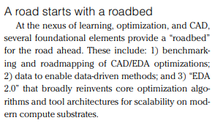
Thought #2: Infrastructure is a Commodity
Claim: Infrastructure is not differentiating
This means Pick one, move on
Data model, DB, incremental STA, readers/writers, standards support, PDK support, logging, scripting, parallelization, GUI … should be like plumbing and utilities
“Don’t need to think about these” is also a Bar !
See:
OpenDB
METRICS2.1
OpenROAD
…
“roadbed for the road ahead”
“more wood behind fewer arrows” !
doi:10.1109/MDAT.2022.3161593
Notes:
Thought Number Two: If it’s infrastructure, it’s a commodity.
INFRASTRUCTURE IS NOT DIFFERENTIATING. IT JUST NEEDS TO EXIST. Should highway signs be green or blue. Should stoplights be vertical or horizontal. PICK ONE AND MOVE ON.
[CLICK] I am convinced that data model, DB, STA, readers and writers, PDK support, loggers, extension language support, GUI – should be like plumbing and utilities – if they work, you don’t think about them. Which is also a BAR.
[CLICK] METRICS2.1 or OpenDB or OpenROAD or whatever – we need the elements of a roadbed upon which we build a road ahead --- for instance, for research on machine learning in EDA which has to include open data and explainable models and optimization benchmarking. We don’t need five roadbeds – but we need at least one.
Standards, interoperability, efficiency, frameworks are everywhere the history of EDA and IC design. Without them, there is just fragmentation of resources, and Towers of Babel, which are BAD.
[CLICK] It really IS a matter of “Put more wood behind fewer arrows!”

Slide 8
Thought #3: Don’t Ignore Proxies!
What else blocks adoption of open-source EDA?
Validations (of relevance)
Root-cause blocker: “not sharable”
Ex: foundry N5 PDKs, enablements are not sharable
grow ASAP7 / ASAP5 PDKs, enablements into research proxies
Ex: commercial EDA SP&R tools/IP are not sharable
can grow OpenROAD, etc. into research proxies
Ex: commercial IPs are not sharable
can grow NVDLA, OpenPiton, Chipyard, etc. into research proxies
Improve proxies to unblock ourselves !
“A journey of a thousand miles begins with a single step”
Notes:
And Thought Number Three: We shouldn’t forget that Good Proxies are essential to the development and adoption of open-source EDA.
Open-source EDA is often rejected because there is poor validation or confirmation of relevance. And the root cause of this:
[CLICK] Something, Somewhere, was NOT SHARABLE.
[CLICK] NOT sharable implies the need for high-quality, open PROXIES. Proxy PDKs and enablements, Proxy EDA tools that we can benchmark and record data from. Relevant Proxy testcases and design drivers.
If proxies aren’t good enough today, [CLICK] it blocks the entire community – and the community needs to invest efforts accordingly.
[CLICK] It may be a journey, but there’s a saying for that.

Slide 9
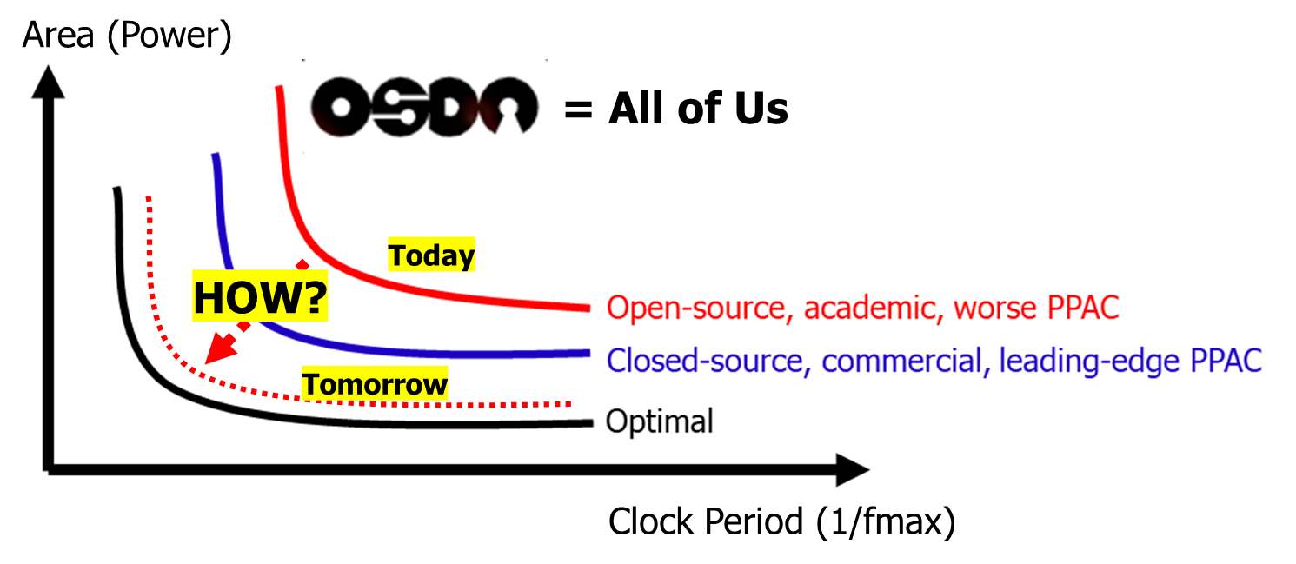
Conclusions
Efficiency is the biggest challenge for open-source EDA
Here to discuss and learn: how to be a better part of the OSDA community, how to achieve more with the people we have
Bars matter: critical mass, critical quality
Infrastructure is not differentiating: pick one, move on
Not sharable is always a blocker: keep improving proxies
What will be the lasting outcomes of this workshop?
Collaboration, synergy, efficiency, “more wood behind fewer arrows”, … ?
Notes:
So in conclusion … this really was an OpenROAD talk. Efficiency has always been the biggest challenge – how can we move faster and achieve more as a community?
[CLICK] Three thoughts were: First, the Bars of critical mass, critical quality matter. Second, Infrastructure is a commodity, it’s not differentiating – so pick something and move on. And it’s actually VERY HARMFUL to try to build five different roadbeds when the end goal is to have a road. Third, not sharable always ends up being a blocker – so we need to continually improve proxy PDKs, tools and enablements.
[CLICK] What will be the lasting outcomes of this workshop? Hopefully, new friendships and synergies formed today will take us more quickly to a better tomorrow.

Slide 10
Some Links (talks are always posted at vlsicad.ucsd.edu)
“Leveling Up: A Trajectory of OpenROAD, TILOS and Beyond”, Proc. ISPD, March 2022. .pdf .pptx
“Our Real Scaling Challenge: People”, ACCESS-CEDA seminar, Sept. 2022. .pptx
“Bars and Barriers to Overcome for Shared ML EDA Infrastructure”, NSF Workshop on Shared Infrastructure for Machine Learning EDA, March 2023. .pptx
Thoughts on open source in EDA
2002: “Toward CAD-IP Reuse: The MARCO GSRC Bookshelf of Fundamental CAD Algorithms” [.pdf] (also: [.pdf])
2019: “Looking Into the Mirror of Open Source” [.pdf]
2020: “Open-Source EDA: If We Build It, Who Will Come?” [.pdf]
2021: “The OpenROAD Project: Unleashing Hardware Innovation” [.pdf]
2022: “The OpenROAD Project: A Foundation for Research and Education in EDA and IC Design” [.pptx]
2022: A. B. Kahng, “A Mixed Open-Source and Proprietary EDA Commons for Education and Prototyping”, [.pdf] [.pptx]
“https://theopenroadproject.org and https://github.com/The-OpenROAD-Project
Notes:
Here’s my usual Links slide, and

Slide 11
THANK YOU !
Notes:
Thank you for the chance to be here today.

